Slide 1


Definition
conflicts are the expression of opposing interests
  Is a process that begins when one party perceives that another party has negatively affected, or is about to negatively affect, something that the first party cares about.
    Is that point in an ongoing activity when an interaction “crosses over” to become an interparty conflict.

Slide 2

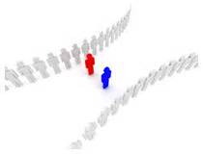
Transitions in conflict Thought:
The traditional view of conflicts.
The human relation view of conflicts
The interactions view of conflict.

Slide 3
Traditional view of conflict
“They belief that all conflicts are harmful and must be avoided”
Causes:
Poor communication
Lack of openness
Failure to respond to employee needs

Slide 4
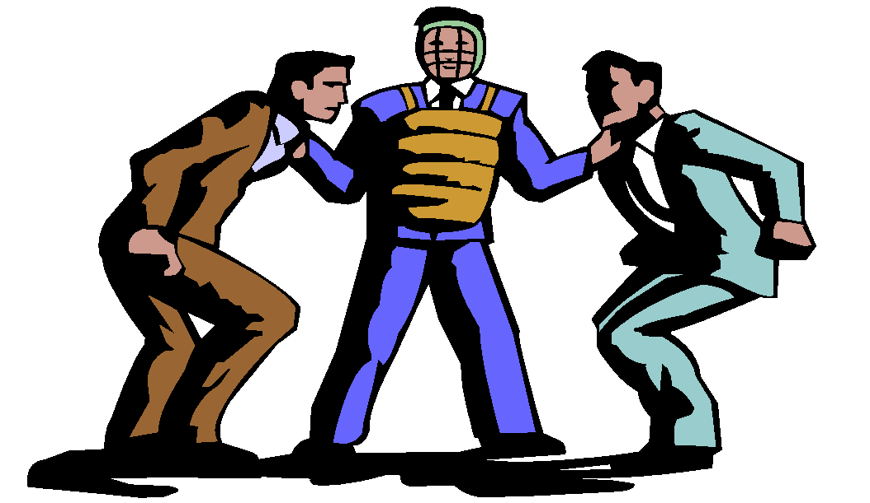
Transitions in Conflict Thought (cont’d)
Human Relations View of Conflict
“The belief that conflict is a natural and inevitable outcome in any group.”

Slide 5
Transitions in Conflict Thought
Interactions View of Conflict
The belief that conflict is not only a positive force in a group but that it is absolutely necessary for a group to perform effectively.

Slide 6
Functional versus Dysfunctional Conflict
Functional Conflict
Conflict that supports the goals of the group and improves its performance.
Dysfunctional Conflict
Conflict that hinders group performance.

Slide 7
Types of Conflict
Task Conflict
Conflicts over content and goals of the work.
Relationship Conflict
Conflict based on interpersonal relationships.
Process Conflict
Conflict over how work gets done.

Slide 8

The conflict process
A process that has five stages: potential opposition or incompatibility, Cognition and personalization, intensions, behavior and outcome

Slide 9
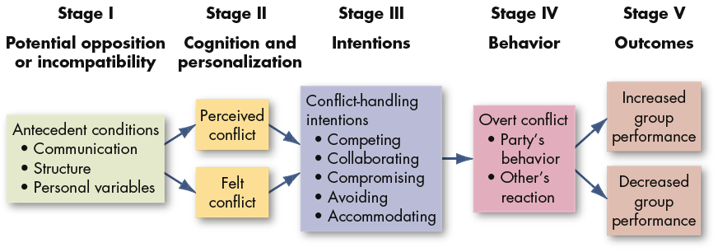
The Conflict Process

Slide 10
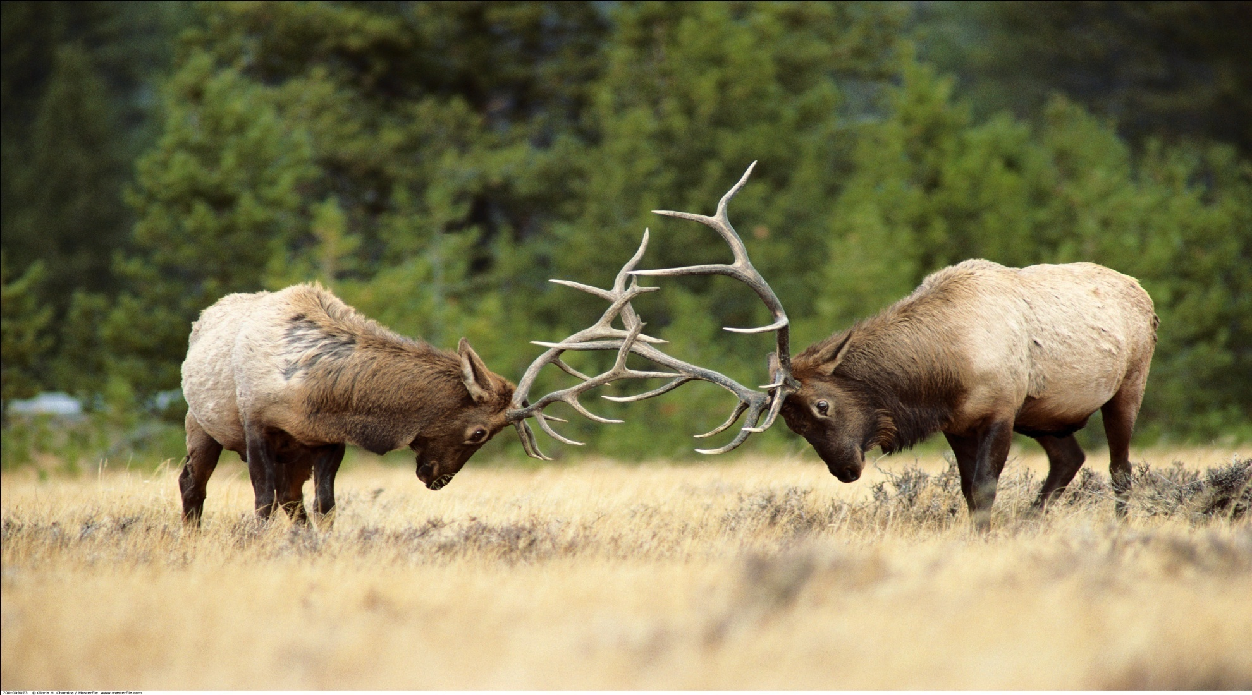
CONFLICT PROCESS & CONFLICT HANDLING

Slide 11
The Conflict Process
Stage 1
  Potential Opposition or incompatibility
    Factors are present that can lead to conflict
      Communication
      Structure
      Personal variables

Slide 12
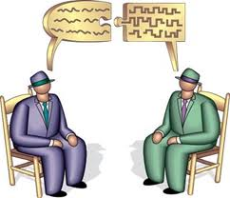
Stage I: Potential Opposition or Incompatibility
Communication
  Semantic difficulties, misunderstandings, and “noise”
Different words connotations, insufficient exchange of information and noise in communication channel are all antecedent conditions to conflict. Too much communication as well as too little communication can lay the foundation for conflict.

Slide 13
Stage I: Potential Opposition or Incompatibility
Structure
  structure is used to include variables such as
  Size and specialization of jobs
  Member/goal incompatibility
  Leadership styles (close or participative)
  Reward systems (win-lose)
  Dependence/interdependence of groups

Slide 14

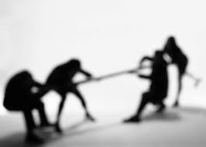
Stage I: Potential Opposition or Incompatibility
Structure
The larger the group and the more specialized its activities, the greater the likelihood of conflict. Tenure and conflict have been found to be inversely related. The potential for conflicts tends to be greatest when group members are younger and when turnover is high.

Slide 15

Stage I: Potential Opposition or Incompatibility
Personal Variables
  Differing individual value systems
  Personality types
  Our last category of potential source
  of conflict is personal variables,
  which include personality,
  emotions and values.

Slide 16

Stage 2: cognition and personalization
If the conditions negatively affect something that one party cares about in the first stage, then the potential for opposition for incompatibility becomes actualized in the second stage.

Slide 17
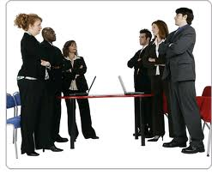
Perceived Conflict
Awareness by one or more parties of the existence of conditions that create opportunities for conflict to arise.

Slide 18
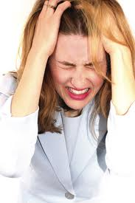
Felt Conflict
Emotional involvement in a conflict creating anxiety, tenseness, frustration, or hostility.

Slide 19
Main two points
First point:
This is the place in the process where the parties decide what the conflict is about.

Slide 20
Second point
Emotions play a major role in shaping perception.
Negative emotions:
It have been found to produce oversimplification of issues, reductions in trust and negative interpretation of the other party’s behavior
Positive feeling:
It have been found to increase the tendency to see potential relationship among the element of problem, to take a broader view of the situation and to develop more innovative solution

Slide 21
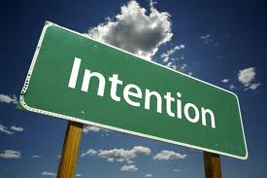
Stage 2: intention
Intentions
Decisions to act in a given way

Slide 22
Dimensions
d
Cooperativeness:
Attempting to satisfy the other party’s concerns.
Assertiveness:
Attempting to satisfy one’s own concerns.

Slide 23
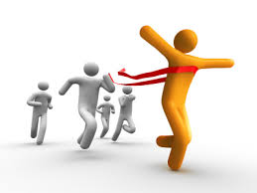


Competing
A desire to satisfy one’s interests, regardless of the impact on the other party to the conflict.
Collaborating
A situation in which the parties to a conflict each desire to satisfy fully the concerns of all parties.
Avoiding
The desire to withdraw from or suppress a conflict.

Slide 24
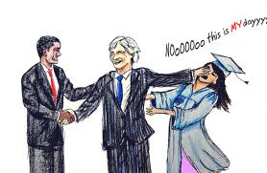
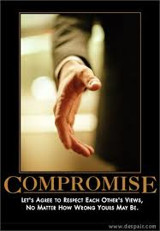
Accommodating
The willingness of one party in a conflict to place the opponent’s interests above his or her own.
Compromising
A situation in which each party to a conflict is willing to give up something.

Slide 25
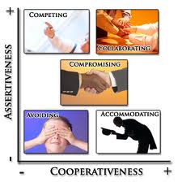

Slide 26
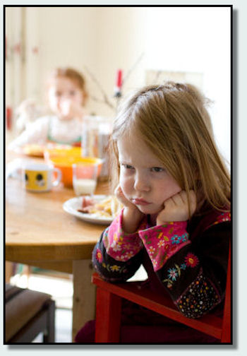
BEHAVIOR

Slide 27
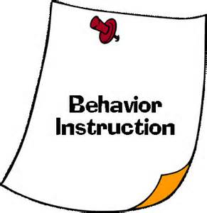
Essential Points
The behavior stage includes statements, actions and reactions made by conflicting parties.
In this stage, where conflicts become visible.
Conflicts characterized by subtle, indirect and highly controlled form of tension.

Slide 28
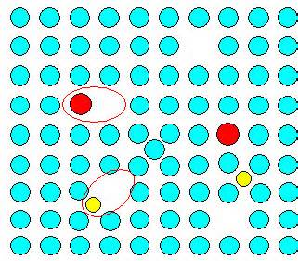
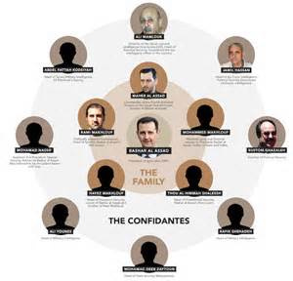
Conflict Intensity Continuum
Conflict intensities escalate as they move upward along the continuum until they become highly destructive.
Strikes, riots, and wars clearly fall in the upper range.
Functional conflicts are typically confined to the lower range of the continuum.

Slide 29
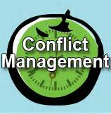
Conflict Management Techniques
If a conflict is dysfunctional, What can parties do to de-escalate it?
1-Problem solving
2-Subordinate goals
3-Expension of resources
4-Avoidance
5-Compromise

Slide 30
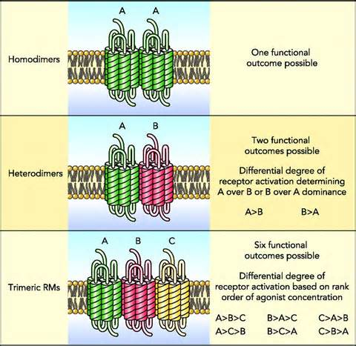
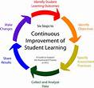
OUTCOMES
The action reaction interplay between conflicting parties results in consequences.

Slide 31
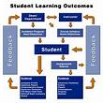
ANSWER
FUNCTIONAL OUTCOMES
How might conflict act as a force to increase group performance?

Slide 32

EXTRAS
1-Constructive conflicts also be positively related with productivity.
2-Conflict also reduced chance that groupthink would overpower policy decisions.
3-The preceding leads to predict that the increasing cultural diversity of workforce should provide benefits to organizations.

Slide 33
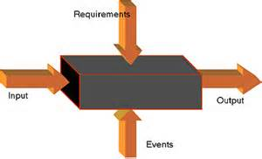
DYSFUNCTIONAL OUTCOMES
Dysfunctional varieties can reduce group effectiveness, reductions in group cohesiveness, and subordination of group goals to primacy of infighting among members.

Slide 34
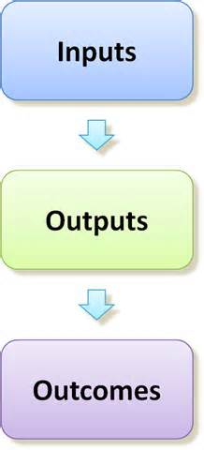
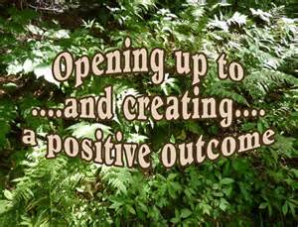
Creating Functional Conflict
A high proportion of people who get to top are conflict avoiders.
Rewards dissent and punish conflict avoiders creates functional conflict .
Example: Managers

